Slide 1
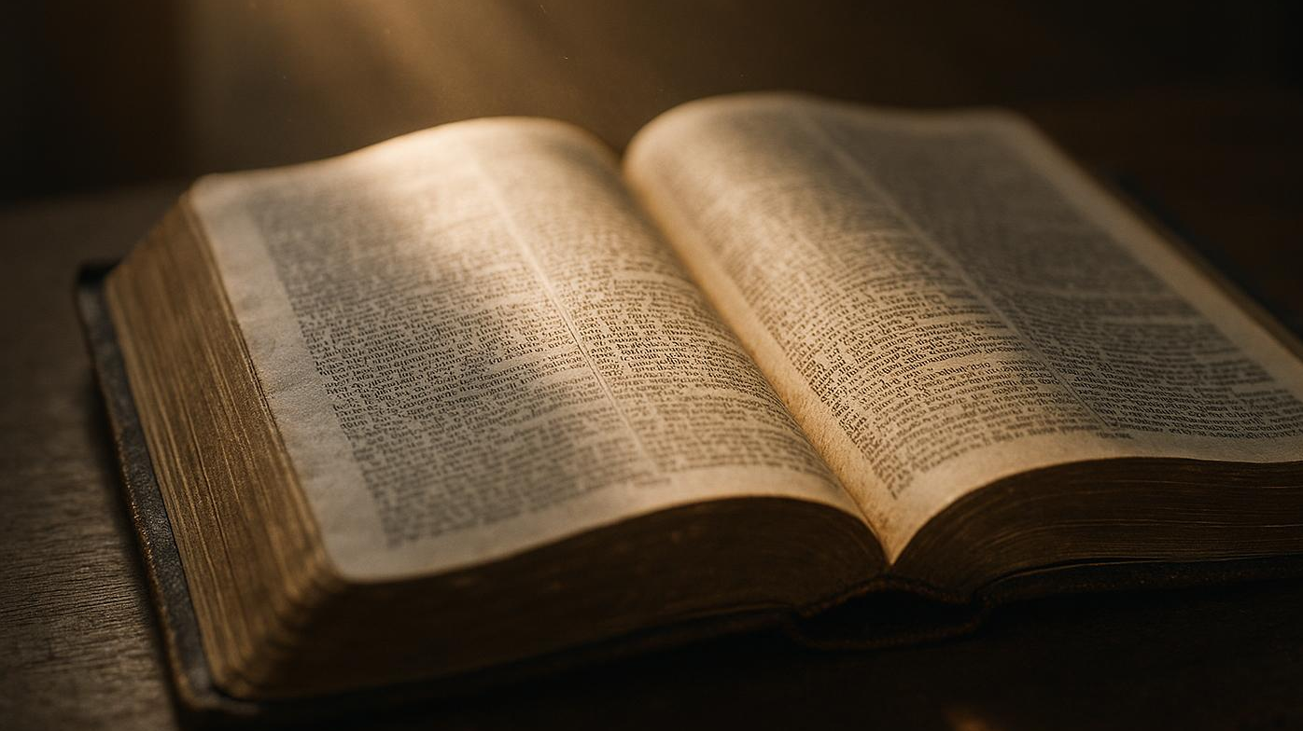
Six Things to Consider: Biblical Priorities for a Fruitful Year
Spiritual Guidance for Growth and Meaningful Living
Notes:
AI-generated content may be incorrect. --- Image source: AI-generated

Slide 2
#1 – Put God First
John 15.4-5 – “Abide in Me, and I in you. As the branch cannot bear fruit by itself, unless it abides in the vine, neither can you, unless you abide in Me. I am the vine; you are the branches. Whoever abides in Me and I in Him, he it is that bears much fruit, for apart from Me you can do nothing.”
Before you plan goals, plan devotion.
A great year starts when Jesus becomes the root, not the accessory.
Notes:
AI-generated content may be incorrect. --- Image source: AI-generated

Slide 3
#2 – Faith Over Won’t
John 15.7 – “If you abide in Me, and My words abide in you, ask whatever you wish, and it will be done for you.”
Abiding reshapes your inner talk: from “I can’t” to “Christ can grow fruit in me.”
Replace “This year will be the same” with: “God can do more than I expect.”
Notes:
AI-generated content may be incorrect. --- Image source: AI-generated

Slide 4
#3 – Before You Feel it, Worship
John 15.11 – “These things I have spoken to you, that My joy may be in you, and that your joy may be full.”
Worship isn’t a mood; it’s a decision.
Rejoicing is not pretending life is easy—it’s declaring God is still good.
Notes:
AI-generated content may be incorrect. --- Image source: AI-generated

Slide 5
#4 – Reconsider and Cut
John 15.2 – “Every branch in Me that does not bear fruit He takes away, and every branch that does bear fruit He prunes, that it may bear more fruit.”
“What is God trying to grow in me right now?”
“What needs to be cut back so I can be spiritually healthy?”
Notes:
AI-generated content may be incorrect. --- Image source: AI-generated

Slide 6
#5 – Realize Blessings
John 15.5 – “I am the vine; you are the branches. Whoever abides in Me and I in him, he it is that bears much fruit, for apart from Me you can do nothing.”
“Gratitude guards you from bitterness.”
Ask: “What has God put in my hands to serve with this year?”
Notes:
AI-generated content may be incorrect. --- Image source: AI-generated

Slide 7
#6 – Stop Trying; Start Abiding
John 15.4-5 – “Abide in Me, and I in you. As the branch cannot bear fruit by itself, unless it abides in the vine, neither can you, unless you abide in Me. I am the vine; you are the branches. Whoever abides in Me and I in Him, he it is that bears much fruit, for apart from Me you can do nothing.”
Don’t aim at “a better year.” Aim at “a closer walk.”
The goal isn’t perfection—it’s faithfulness.
Notes:
AI-generated content may be incorrect. --- Image source: AI-generated

Slide 8
#1 – Put God First #2 – Faith Over Won’t #3 – Before You Feel it, Worship #4 – Reconsider and Cut #5 – Realize Blessings #6 – Stop Trying; Start Abiding
Notes:
AI-generated content may be incorrect. --- Image source: AI-generated

